Slide 1


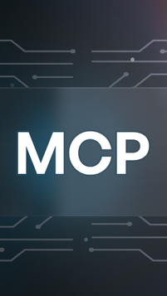
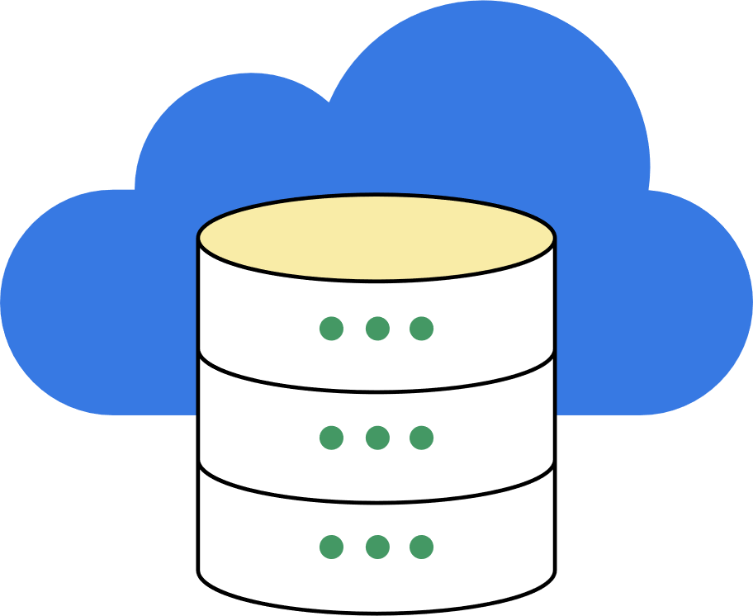

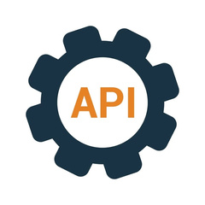

Enterprise Application Workflow (Traditional → AI-Driven)
Agent / Orchestrator
User
API Layer
Business logics
Database/External systems
LLM

Slide 2
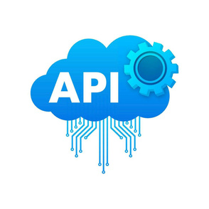




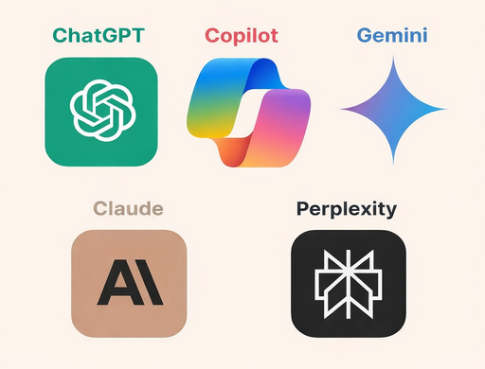


Enterprise MCP Architecture
MCP Host
Database/ External Systems
MCP Server
Web/Mobile Application
  Tool Registry
  Schema Validator
  Router/Dispatcher
  Executor
AI systems
MCP Protocol
(Structured Tool Invocation & Results)
Native System Calls
(DB queries / REST / SDK / CLI)
Available tools
  get_transactions()
  transfer_money()
  send_notifications()
MCP Client
(Request sender/Adapter)
Tool Execution Result (Raw System Output)
Structured MCP
Messagess
(JSON-RPC based)
(request + response)

Slide 3
